Slide 1
AI Awareness and best practices in the Judiciary
Shubham Gaddi, Saquib Hussain, Darshan Upadhyay, Hugo Biczek, Nandini Devalla, Ayush Gupta

Slide 2
Business Problem
Judges in the Indiana Judiciary face challenges with understanding and leveraging AI effectively in their roles. Core challenges include;
1
2
3
Fear & Stigma Surrounding AI – Lack of Awareness
Incorporation of AI in everyday Judicial Processes
Identification & Flagging of AI Generated Content
Notes:
So when we started this project, we realized it was actually pretty open-ended. There wasn’t a set scope or fixed deliverable — which honestly made it more interesting for us. It gave us the freedom to explore what AI means for the legal space and how it could actually be used in a meaningful way.
To make things clearer, we broke it down into three main problem areas. We built these from our initial conversations we had with the judges and few others involved in the porject
The first problem is the fear and stigma around AI. And honestly, that fear isn’t totally wrong. A lot of it comes from not knowing what these tools do or how they work .
One thing I personally feel really strongly about — and something that came up during our research too — is that even people who know how to use AI don’t always use it responsibly. Like, it’s one thing to ask ChatGPT for help writing an email. But it’s another thing to upload a full legal contract or a sensitive client memo into an AI tool just to get a summary.
For example, we found that people have uploaded full legal documents — with things like contract terms or client data — into tools like ChatGPT just to get a quick summary. But once you do that, you don’t really know where that data ends up. And that can lead to privacy issues or even legal trouble. So the hesitation we’re seeing isn’t just about fear — it’s also about protecting sensitive information, which makes complete sense.
The second problem is more about guidance. Even if someone is open to using AI, they might not know where to start or what tools are allowed, how they can help, or where they can be safely used in a daily workflow.
And the third is about AI-generated content. With tools like ChatGPT, it’s becoming easier to create emails, legal arguments, or documents — but right now there’s no easy way to identify if something was created or influenced by AI. And that leads to questions like: should AI-generated content be flagged in court? How do we verify authenticity? Does it change how we evaluate something?
These three areas are what we used to frame the rest of our work.
was generated by AI.

Slide 3
Business Benefits
AI awareness among Indiana judicial officers
Awareness about AI helps breaks fear & stigma around it
Improved productivity & judicial efficiency
More cases/experience leads to higher AI awareness
Improved efficiency leads to savings of time and resources
Flagging AI generated evidence
Faster research means more time to evaluate evidence
Cost & time savings
Notes:
Slide 2: Business Benefits
If we’re able to tackle these problems, we can create a lot of value for the judicial system.
First and foremost is improving the awareness around AI. Just by improving awareness we can help people feel more confident using it sndd Once there’s less hesitation, it opens up the chance to explore where it fits, without fear or confusion.
That leads to better productivity as AI can support research, help draft documents, or automate repetitive tasks — all of which can save time and effort.
It can also help reduce risk. If we build some best practices around how to use these tools — and how to spot AI-generated content — it lowers the chance of mistakes or misuse.
So the goal here isn’t just about “using AI.” It’s about doing it in a way that adds value without introducing unnecessary risk ann that it can actually support the work that’s already being done, without replacing human judgment.

Slide 4
Business to Analytics Problem Framing
Business Problem
Analytics Problem
Quantify organizational gaps in AI awareness
Lack of AI awareness
Process mining for workflow AI integration
AI agnostic daily workflows
Guidelines for probabilistic detection of genAI content
Identifying genAI content
Guidelines for multimodal synthetic media detection
Flagging AI altered content
Notes:
Of course, all of this sounds great at a high level — but to actually move forward, we had to translate these into more tangible, solvable problems. And that’s where analytics comes in.
For the awareness gap, we looked at ways to measure familiarity with AI across different roles — judges, clerks, and court staff. This helped us understand where the hesitation was coming from and where more exposure or training might be needed.
For workflow integration, we analyzed some common judicial processes and identified areas where AI could be safely introduced. The goal wasn’t to overhaul anything — just to see where it could help make things more efficient without interfering with legal judgment.
And for the AI-generated content concern, we explored how detection could work in practice — not necessarily building a complex detection system, but coming up with guidelines and checkpoints that could be used to flag suspicious or fully AI-generated materials.
So the whole idea is to take something that seems broad and a little overwhelming, and turn it into something structured and doable and ofc something that could actually support decision-making and policy in the long run.

Slide 5
Literature Review
Study By | Focus Area | AI Adoption | AI Detection | Policy Consideration | Empirical Evaluation | Limitations Identified
Indiana National Courts and Sciences Institute | Judicial AI Usage | ✓ | ✗ | ✗ | ✓ | ✗
Illinois Supreme Court | AI Policies and Guidelines | ✓ | ✗ | ✓ | ✗ | ✓
National Center for State Courts | AI Advisory | ✓ | ✗ | ✓ | ✗ | ✓
Sadasivan et al. | AI Text Detection | ✗ | ✓ | ✗ | ✓ | ✓
Blümer et al. | Deepfake Detection | ✗ | ✓ | ✗ | ✓ | ✓
Our Study | AI Use in the Judiciary | ✓ | ✓ | ✓ | ✓ | ✓

Slide 6
Project Roadmap & Baseline Metrics

Slide 7
Project Roadmap
Phase 1 : Awareness Packet
Phase 2 : AI in Daily Workflows
Understanding the daily workflows of Judicial Officers and boosting productivity and efficiency by suggesting relevant AI Tools
Two Pronged objectives -> Fact Checking AI Generated Text, References etc & Identifying AI Generated Audio, Video, Images
Phase 3 : Identification & Credibility of AI Generated Content
Understanding common hesitations to using AI & creating an educational packet to mitigate concerns & fear

Slide 8
Baseline Metrics
Manual Assessment of Survey Data
~90% survey responses display either negative or neutral sentiments towards AI
Finding common themes from open ended questions
Picking actionable concerns from the survey report
Key requirements include themes like – training, guidance, ambiguity
NLP Assessment of Survey Data
AI is deemed valuable for resources/processes like – policies, hearings, briefs
Sentiment analysis to gauge current state of AI acceptance/understanding
Key phrase analysis to pick out commonly occurring words
Concerns regarding AI revolve around themes – stakes, ethics, responsibility, danger

Slide 9
Baseline Metrics
Are there any other resources that were not listed that you would find valuable as a judicial officer?
What else would you like to share about the use of AI as a judicial officer?
What additional tools or guidance would be helpful?
8.5%
10.9%
8.5%
11.4%
8.5%
56.8%
31.8%
58.7%
30.4%
83%

Slide 10
Metrics for Success
Reduction in Negative Sentiment
< 10%
AI Supported Daily Workflows/Use-Cases
5
Accuracy in Flagging AI Content
~80%

Slide 11
AI Awareness Packet

Slide 12
Objectives
Definitions & explanations
Courtroom use cases
Considerations & pitfalls
Explain the basic functions of AI and AI tools
Create exercises to build comfort around AI tools
Examples in legal workflows
Sample, DIY exercises for familiarity

Slide 13
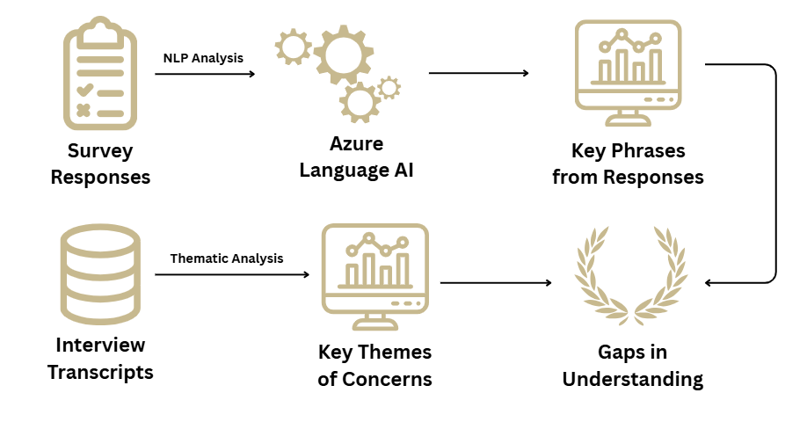
Identifying Gaps in Understanding

Slide 14
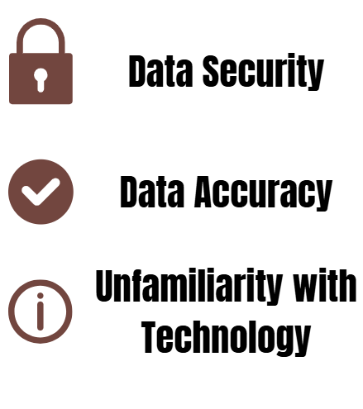
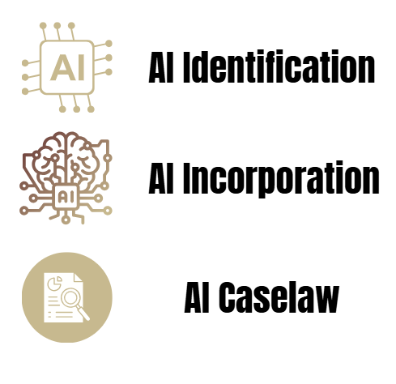
Gaps in Understanding - Identified

Slide 15
Solution - AI Onboarding & Training
The packet contains of 6 major stages, each of which covers a theme,
Basics of Modern Day AI
Generic AI Use-Cases & Case studies
Limitations & Considerations
Sample Legal Use-Cases
DIY Exercises for AI Experimentation
FAQs & Further Resources
Understanding Artificial Intelligence: A Primer for the Judiciary
AI Tooling & Common Use Cases Across Industries
The Promise & Perils of AI in the Judiciary
AI: Enhancing Judicial Efficiency and Access to Justice
Hands On: Experiments with Common AI Tools
Prompt Engineering for Judges

Slide 16
Content Overview
Understanding Artificial Intelligence: A Primer for the Judiciary
AI Tooling & Common Use Cases Across Industries
The Promise & Perils of AI in the Judiciary
Healthcare – Mayo Clinic Case Study
Finance – JP Morgan Case Study
Education – Arizona State University Case Study
Retail – Amazon Case Study
Manufacturing – Toyota Case Study
Inherent Limitations of AI
Bias in Decision Making
Lack of Transparency – Black Box Model
Hallucinations & Inaccuracies
Over-reliance on AI tooling
Data Privacy
Introduction to AI
Types of AI
Modern AI Landscape
Why AI matters to the Judiciary
Common Limitations
Incentive for Judges to use AI
AI as a Catalyst for Modern Justice

Slide 17
Content Overview
Enhancing Judicial Efficiency & Access to Justice
Hands on Exercises – Building Familiarity with AI
Prompt Engineering for Judges, FAQs and Further Reading
Legal Research – CARA AI
E-Discovery – Kira Systems
AI based Case Outcome Predictions – Lex Machina
AI powered Transcription – Verbit
AI for Bias Detection – Hollistic AI
Summarization with Quillbot
Transcription with Otter.ai
Writing improvements with Grammarly
Real-time translations with Google Translate
Ideation with GPTs
AI Detection with Quillbot
What is Prompt Engineering?
Technical Aspects and Evolution with Time
Elements of writing Good Prompts
Ethical Considerations & Relevance to the Judiciary
Examples and Use - Cases for Legal Processes for Familiarisation

Slide 18
AI in Daily Legal Workflows

Slide 19
Objectives
Understand a Judges' Daily Workflow
Identify tasks suited for AI Tool
Suggest AI – Aided Workflows for Efficiency
Find scope for AI aided daily workflows
Identify Operational & Recurring Tasks
Automate through AI Tools
Allow Judges to Focus on Decision Making
Automate operational tasks

Slide 20
Methodology – Qualitative Interviews
Selection of Judges from the System
Level of Familiarity with AI Tools & Key Concerns
Random selection of judges by IOCS
Diversity in 2 main factors,
Experience on the Bench
Jurisdiction/Type of Court
Preferred Mode of Instruction & Desired AI Support
Creation of Interview Questionnaire
Most Time-Consuming Daily Activities
Understand tasks that judges, ideally, want to spend less time on
Find out processes that are inefficient or can be sped up through AI
Expectations from an Ideal AI Companion

Slide 21
Understanding the Judges
Familiarity with AI & AI Tools (ChatGPT, Quillbot etc.)
Most Time Consuming, Recurring Activities
7.1%
14.3%
25%
21.4%
7.1%
37.5%
21.4%
21.4%
37.5%

Slide 22
Key Findings & Observations
We can categorize most concerns that came out of the interviews with the judges into 3 main problem pools,
1
2
3
Repetitive & Monotonous Work is a Major Burden
Time Diversion towards Grunt Work is significant
Training Preferences vary across Experience

Slide 23
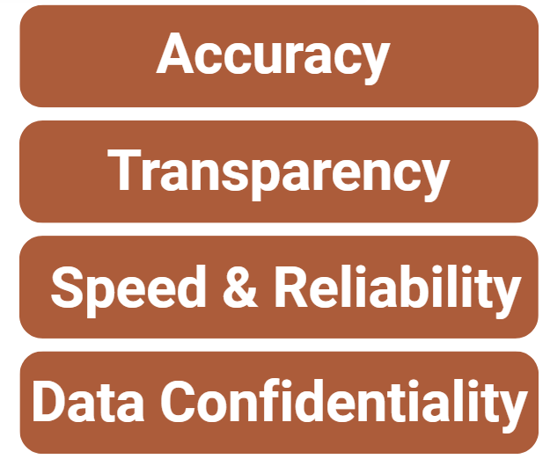
Expectations from an AI Aide
Accuracy is of paramount importance – AI based errors are unacceptable
Tools should provide noticeable benefits with a low learning curve
Explainability is paramount – black boxes are deal breakers
Data confidentiality is the problem in most cases – court documents are not meant for the training loop

Slide 24
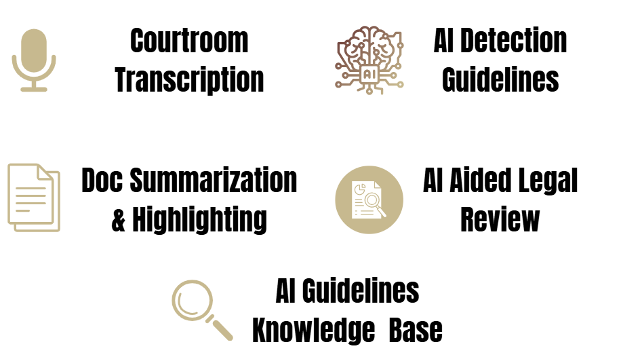
Targeted Workflows

Slide 25
AI Generated/Altered Content Flagging

Slide 26
Objectives
Create & identify reasonable doubt
Identify AI Generated Filings – extra caution
Flag AI Generated/Altered Media Evidence
Find Reasonable Doubt
Maintain objectivity in Verdicts
Probabilistic Identification of AI generated or altered Evidence
Ensure fairness & transparency

Slide 27
Constraints & Requirements
Pre - Trial Requirements
Transparent model with probabilistic output – how likely is a media AI generated/altered
Identify AI Generated Filings
Identify AI Generated Citations
Increased scrutiny & reviews for GenAI work product
Identify which part of the Image/Video has AI tampering - rule on admission
In - Trial Requirements
Ability to Identify gives the Judiciary the ability to Regulate – AI Watermarking
Identify & flag AI generated media – informed decision to admit evidence
Identify & flag AI altered media – create reasonable doubt about extent of impact
Where to Go : In – House AI identification capabilities & infrastructure

Slide 28
Text Identification
Dataset – 50 Essays (50% AI-generated)
Cost – Usage Limits & Pricing
Transparency – Blackbox output v/s explained output
Ease of Use – Intuitive UI, Account Creation etc.

Slide 29
Image Identification
Dataset – 50 Images (Mixed Sources)
Cost – Usage Limits & Pricing
Transparency – Blackbox output v/s explained output
Ease of Use – Intuitive UI, Account Creation etc.

Slide 30
Video Identification
Dataset – 50 Videos (Mixed Sources)
Cost – Usage Limits & Pricing
Transparency – Blackbox output v/s explained output
Ease of Use – Intuitive UI, Account Creation etc.

Slide 31
Summary & Next Steps

Slide 32
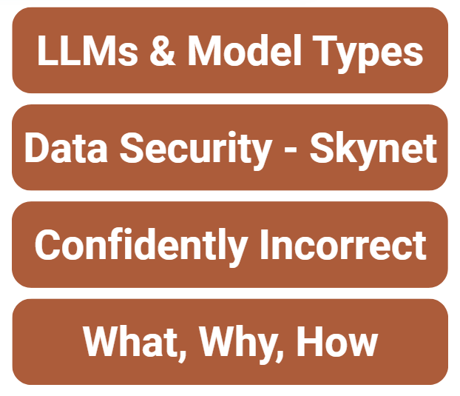
Awareness Packet – Relevance
Major Misconception – AI is the early coming of Skynet
AI is your typical consultant – confidently incorrect
Does using AI provide access to all files on the system?
GPT 4o, o1 mini, Claude Sonnet 3.5, DeepSeek R1 – new terminator models?

Slide 33
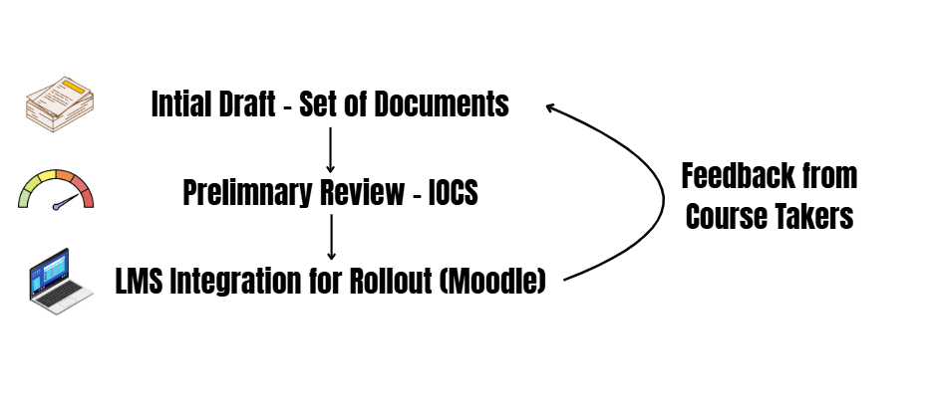
Awareness Packet – Next Steps
New Course setup on Moodle for distribution to Judges
Feedback form included at the end of the course
Feedback summary shared with IOCS routinely

Slide 34
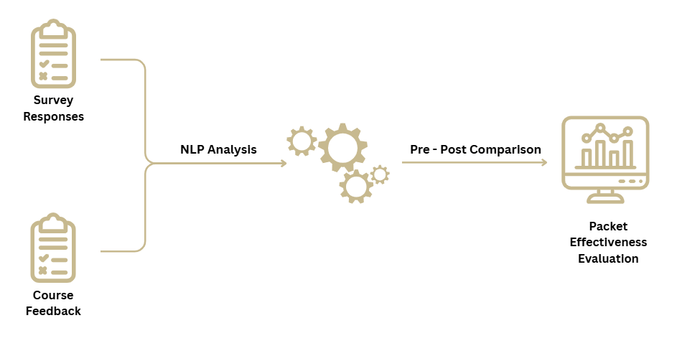
Awareness Packet – Next Steps
LMS course feedback will have questions to gauge,
Change in familiarity with AI
Updated thoughts about AI
Addressal of previous concerns
These will be used to perform a similar analysis to the original survey
Results will be compared to evaluate efficiency. Process will be automated

Slide 35
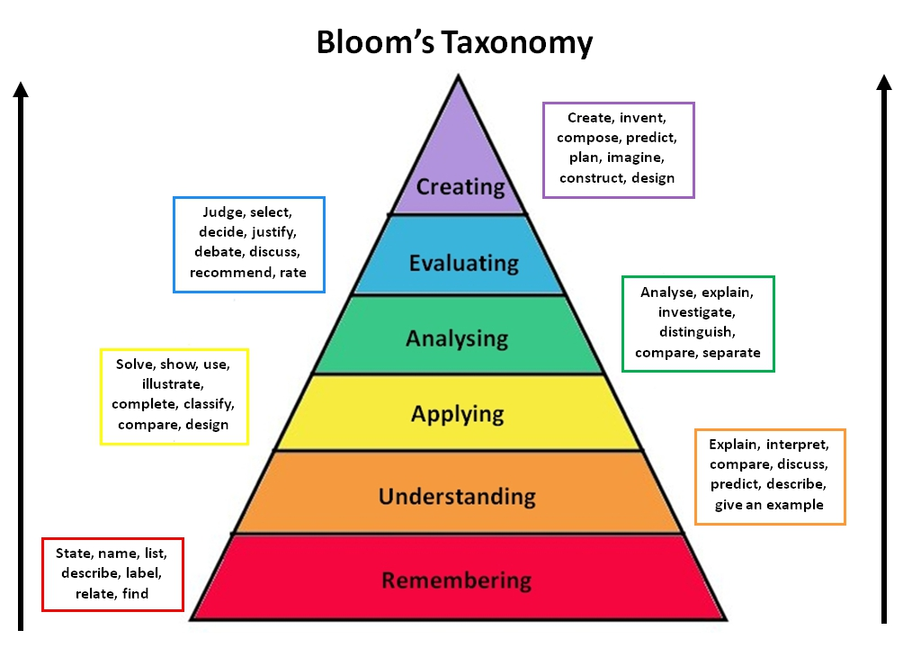
AI in Daily Workflows – Relevance
Help ease the boredom of repetitive, routine and operational tasks
Help reduce the dependance on trained labor – speeding up potential court processes
Great at knowledge retention, average at higher order thinking
World's best know-it-all helper/assistant

Slide 36
AI in Daily Workflows – Next Steps
Original Objectives
Detailed report about the conversations with judges
Understand and identify relevant workflows
Setup pilot programs with AI tools to for test runs
Identification of common concerns and workflows that need change
Challenges
Understanding the expectations from a good AI tool
Tight schedules – took longer than expected to find time with judges
Slow feedback and approval cycles – led to lack of time for pilot implemetation
System Designs for AI Implementation in the future
36

Slide 37
AI Detection Guidelines – Next Steps
Phase 3 – Ten to Hundred
Phase 1 – Zero to One
Phase 2 – One to Ten
Market Analysis – Available Tools
Guidelines & Instruction
Hierarchy of Detection Tools
Cost
Transparency
Accuracy
Reliability
Use of available AI Tools for Detection
Assessment, Performance & Integration testing for Cloud based AI Detection Tools
Top Choices,
Azure Sentinel
AWS Rekognition
Deployment of Cloud Based AI Detection
Increased control over limits, transparency, granularity etc
Design and development of In - House algorithms for AI Detection
Mixed Use – Cloud + Native Algorithms

Slide 38
Appendix & Glossary

Slide 39
Distribution of Work
 | Ayush Gupta | Saquib Hussain | Hugo Biczek | Darshan Upadhyay | Nandini Devalla | Shubham Gaddi
Week 1 (20/01 - 26/01) | INFORMS Registration, Slide Deck | INFORMS Registration, Slide Deck | INFORMS Registration, Slide Deck | INFORMS Registration, Slide Deck | INFORMS Registration, Slide Deck | INFORMS Registration, Slide Deck
Week 2 (27/01 - 02/02) | Slide Deck | Slide Deck | Educational Packet | Educational Packet | Educational Packet, Sentiment Analysis | Educational Packet, Judge Interview Questions
Week 3 (03/02 - 09/02) | Slide Deck | Slide Deck | Educational Packet | Project Paper, AI Content Flagging | Educational Packet | Project Paper, Scheduling Interviews

Slide 40
Distribution of Work
 | Ayush Gupta | Saquib Hussain | Hugo Biczek | Darshan Upadhyay | Nandini Devalla | Shubham Gaddi
Week 4 (10/02 - 16/02) | Interview with Judge McAdam | Interview Judge McAdam | Interview Judge Weissmann | Interview Judge Sarber | Interview Judge Weissmann | Interview Judge Sarber
Week 5 (17/02 - 23/02) | Interviews | Interviews | Interviews | Paper Literature Review | Interviews | Paper Methodology + Poster
Week 6 (24/02 - 02/03) | Finals Week – Work Paused & IOCS informed about the same

Slide 41
Distribution of Work
 | Ayush Gupta | Saquib Hussain | Hugo Biczek | Darshan Upadhyay | Nandini Devalla | Shubham Gaddi
Week 7 (03/03 - 09/03) | Interview Consolidation | Interview Consolidation | Awareness Packet <> LMS | Awareness Packet <> LMS | AI Detection Study – Text & Audio | AI Detection Study – Images & Videos
Week 8 (10/03 - 16/03) | Interview Consolidation | Interview Consolidation | Awareness Packet <> LMS | Awareness Packet <> LMS | AI Detection Study – Text & Audio | AI Detection Study – Images & Videos
Week 9 (17/03 - 23/03) | Spring Break – Work Paused & IOCS Informed about the same

Slide 42
Distribution of Work
 | Ayush Gupta | Saquib Hussain | Hugo Biczek | Darshan Upadhyay | Nandini Devalla | Shubham Gaddi
Week 10 (24/03 - 30/03) | AI Tooling Review - Text |  | AI Tooling Review – Images & Tutorial Videos | Poster Preparation & Video | Paper Review & Preparation | AI Tooling Review - Videos
Week 11 (31/03 - 06/04) | Documentation & Consolidation Saquib & Ayush involved in INFORMS |  |  | Moodle Access & LMS Integration Shubham also involved in MWDSI Darshan Involved in INFORMS
Week 12 (07/04 - 13/04)

Slide 43
Thank You

